Slide 1
Object Oriented Concept, Class, Object, and Package Session 5
Course : COMP 6175
Object Oriented Programming
Effective Period : October 2018

Slide 2
Outline
Class to Object
Constructor
Access Modifier
Method
Overloading Method
Static Variables and Method
Introduction of Package
Creating and Naming Package
Using Package

Slide 3
Concept of Object Oriented
Object Oriented Programming (OOP) is a technique to create object-oriented programs.
An object described by entities in the real world that can be clearly identified. Example: students, cars, desks and other things that can be viewed as objects.
Objects in programming languages must have the behavior / method, property, type, and identity.

Slide 4
Concept of Object Oriented(continue)
All data and functions wrapped in classes and objects.
OOP provides the facility to write a program to change the actual object in the component programming code.

Slide 5
Concept of Object Oriented(continue)
An object-oriented languages such as Java combine language skills in the procedure by adding a dimension that provides: more flexible, clear, easier to use back through abstraction, encapsulation, inheritance, and polymorphism.
Other advantage of OOP :
Allows the use of real world modeling
Support the reuse of existing code
Provide flexibility in modifying existing applications
Assist with ease of maintenance of existing code

Slide 6
Concept of Abstraction
The ability of a program to bypass aspects of the information processed by it, namely the ability to focus on the core.
Implement the class separation of the user of a class
Focus on the object characteristics that distinguish one type from another object
Every object in the system serve as a model of the "actors" who can do abstract work, reports and changes in circumstances, and communicate with other objects in the system, without disclosing how the excess is applied.

Slide 7
Concept of Encapsulation
Details of the implementation shown in the summary and hidden from the user.
User objects can not change the situation in a way that is not feasible, only the method in which objects are given permission to access the situation.

Slide 8
Concept of Inheritance
Inheritance of properties from another class (parent class), so having the characteristics or nature of the class.
Each class can have only one parent class (superclass), and their respective parent classes may have a child class (subclass) that is not limited.
In OOP allows for a general class medefinisikan (general class) and the new one to set up some classes by adding some detail a simple code using the old class definition.

Slide 9
Concept of Inheritance
One method has many implementations behavior
The ability of an object has a variety of forms depending on the situation
Polymorphism provides flexibility for an application based on the needs
Simplify the code and reduce code the same workmanship as required in developing and modifying applications
Class inheritance can be implemented with interfaces or both

Slide 10
Defining Class for Object
OOP involves programming using objects.
An Object represent an entity in the real world that can be distinctly identified.
Class is a template of the object, which defines the properties of objects, and provides constructors to create objects and methods to manipulate objects.
A class is also a type of data, can be used to express the object referenced by the variables.

Slide 11
Defining Class for Object (Cont.)
An object of the class have:
Unique identity
State – data field, properties.
Behavior – one or a set of method or function
Example: A circle has a data field, the radius, which is a characteristic of the properties of the circle.
Class : Circle
Data Fields :
Radius
Methods :
getArea

Slide 12
Defining Class for Object (Cont.)
Use the new operator to create objects and operator dot (.) To access the member object
Circle obj = new Circle();
System.out.println(“area radius of the circle is ” + obj.getArea());

Slide 13
Constructors
Constructors are a special kind of method. They have three peculiarities:
A constructor must have the same name as the class itself
Constructors do not have a return type – not even void
Constructors are invoked using the new operator
Circle obj = new Circle();
Class
Object for
Class Circle
Constructor for
Class Circle

Slide 14
Access Modifiers
Private : hide the class members so not accessible from outside the class
Protected : allows members of the class can be accessed by the class or its derivatives in the classroom several similar packages.
Public : allows the member class can be accessed by other classes class
Package : used to organize classes. If the class that was created without using the package statement, the class will be placed in the default package.

Slide 15
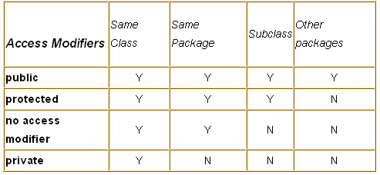
Access Modifiers (Cont.)

Slide 16
Method
Ability of objects
In a programming language commonly known as a function / procedure
Specification of header method
modifier return_value_type method_name(parameters){
// Function contain
}
Passing parameter by value is sending the value of a function that is in a class.
A function allowing for the return value. Only void that does not return value from method
public void setRadius ( double r )
{
radius = r;
}
Send a value to
setRadius function
Access public modifier with data type void
that does not return value

Slide 17
Method ( Cont’d… )
A function will return the value in accordance with a data type functions.
public double getRadius ()
{
return radius;
}
Advantage of Method :
Reusable. Function can be used to reduce repetitive coding and the same coding can be used repeatedly by invoking the name of the function and can be used in other programs.
Modularize. Function makes the code into modules, so easy to search its mistakes and improve the quality of the program.
Maintainable. Easy to maintain.
Functions that return values of its
callers with the data type double
and the nature of access is public
Returns a value equal to
data type data type functions

Slide 18
Overloading Method
Have two or more names for the same function in a class with a sequence of different parameters.
public class TestOverloading{
public static int max( int a, int b, int c ) {
if ( a > b )
return a;
else
return b;
}
public static double max( double a, double b ) {
if ( a > b )
return a;
else
return b;
}
public static double max( double a, double b, double c ) {
return max( max( a , b ) , c );
}
}

Slide 19
Abstract Class
Classes which are declared abstractly.
Abstract classes cannot be instantiated, but they can be subclasses
Always defined in abstract class
public abstract class Circle
{
private double radius;
public void setRadius ( double x ) {
radius = x;
}
public abstract double getArea();
public abstract void setRadius();
}
Abstract method which
return value type
double
Abstract method without
returning of value
And Overloading method

Slide 20
Static Variables and Methods
Variable radius in class Circle is an instance variable
If you want to use all of data of the entire event (instance) in a class, use static variables.
Static Variables store value in local memory.
Static Methods can be called without creating objects from the class.
public class Circle {
private double radius;
private static int numberofObject = 0; //static variable
public static int getArea() { //static method
return numberofObject++;
}
}

Slide 21
Constants
Used by all objects in class
Must be declared with the keywordfinal static
Example : PI constant in class Math
final static double PI = 3.14159265358979323846;

Slide 22
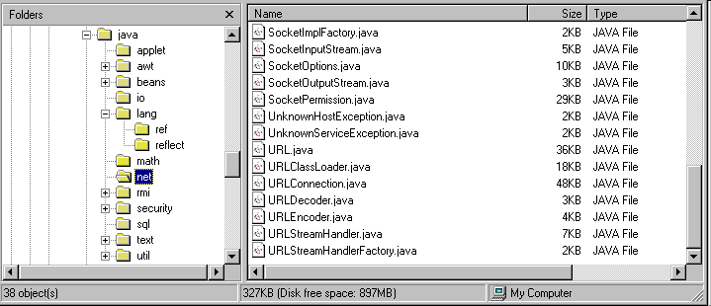
Introduction
Organize files in a directory that has the same function.
Facilitate in developing a large project.
Example of package JDK from SUN (java.xxx.yyy) is shown as follows:

Slide 23
Introduction ( Cont’d.. )
Advantage of using package :
Collision avoid class name that we created with the existing class.
Easy in maintenance and development (grouping)
Ease in searching and using the class name and its access control
Understand the concept of Package will assist in managing and using files saved in the JAR (Java Archive) more efficient.

Slide 24
Creating and Naming Package
Steps to create package :
Create a directory that represents location where a package will be made
Example: D:\Java\Proyek\MyPackage\Poligon
Create a class (or interface) which will be the contents of the package that we will create with the composition:
// Package declaration package packagename;
// Class declaration public class classname{ … }

Slide 25
Creating and Naming Package ( cont’d..)
Package Declaration Using keyword package which written in the first row of source file (.java).
package packagename;
Example :
package MyPackage;
package MyPackage.Poligon;
Class Declaration Expressed in public so it can be accessed by all classes that exist within and outside of the created package.
If there are several classes in the source file, there is a class only can be expressed in public, i.e., the class whose name is the same as the name of the source file.
There can be only one package statement
on each source file

Slide 26
Using Package
There is 2 way to use class in the package:
By referring to package name from its class
Example :
Compilation result of class SegiEmpat in directory Polygon
MyPackage.Polygon.SegiEmpat S;
S = new MyPackage.Polygon.SegiEmpat(17, 8);
or
MyPackage.Polygon.SegiEmpat S = new MyPackage.Polygon.SegiEmpat(17, 8);
By using import
import MyPackage.Polygon.*; import MyPackage.Polygon.SegiEmpat;
To use :
SegiEmpat s = new SegiEmpat(17, 8);
Import wildcard all Java
classes in the
directory Polygons

Slide 27
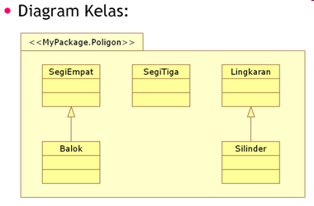
Using Package ( Cont’d.. )

Slide 28
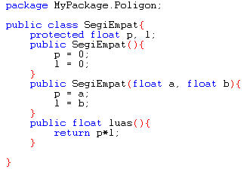
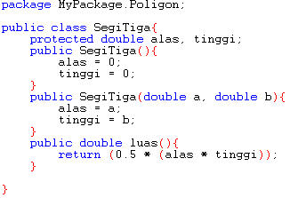
Sample Code
Example of 2 Java file in Poligon package:
Orderred result of Java class file compilation which create will be put in the folder.
If the folder havent created, the compiler will create it.
Class File SegiEmpat.java
Class File SegiTiga.java

Slide 29
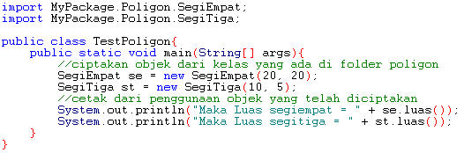

Sample Code ( Cont’d.. )
If used, then :
Output:
To use it, previously import class
which will be use

Slide 30
References
Daniel Liang, Y., 2015, Introduction to java programming, vol.10, Pearson Education, New Jersey.
Package
http://en.wikipedia.org/wiki/Java_package
http://www.jarticles.com/package/package_eng.html
http://java.sun.com/docs/books/tutorial/java/package/packages.html
http://tinf2.vub.ac.be/~dvermeir/java/other_doc/JavaPackages.html
http://dancpm.wordpress.com/2008/01/14/package-on-java-programming/
Method
http://en.wikipedia.org/wiki/Class_method
Class
http://en.wikipedia.org/wiki/Class_(computer_science)
Class and Object
http://java.sun.com/docs/books/tutorial/java/javaOO/index.html

